Slide 1



Setting the Testing Options
And Global Options
NHS Automation Team

Slide 2
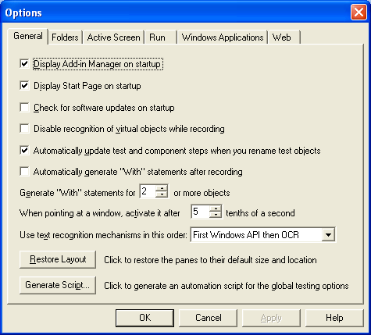
Set Global Testing options
Setting the Testing And Global options
We can use the Options dialog box to modify your testing options. The values you set remain in effect for all subsequent record and run sessions.
To set global testing options:
1. Choose Tools > Options or click the Options toolbar button. The Options dialog box opens.

Slide 3
Different Object Properties Types
Setting the Testing And Global options
Different Tabs in Options dialog box are :
General
Folders
Active screen
Run
Windows applications
Web

Slide 4
Setting General Testing Options
Setting the Testing And Global options
The General tab includes the following options:
Display Add-in Manager on startup
Display Start Page on startup

Slide 5
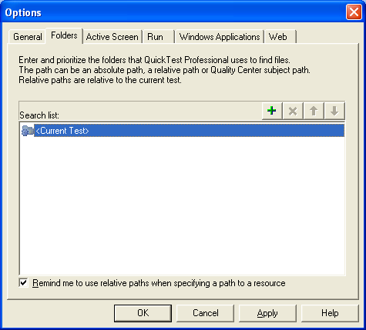
Setting Folders Screen Options(Contd…)
Setting the Testing And Global options
The Folders tab enables you to enter the folders (search paths) in which QuickTest searches for tests, actions, or files that are specified as relative paths in dialog boxes and statements.

Slide 6
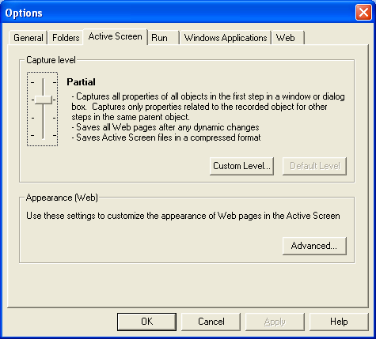
Setting Active Screen Options(Contd…)
Setting the Testing And Global options
The Active Screen tab enables you to specify which information QuickTest saves and displays in the Active Screen while recording and running tests and components.

Slide 7
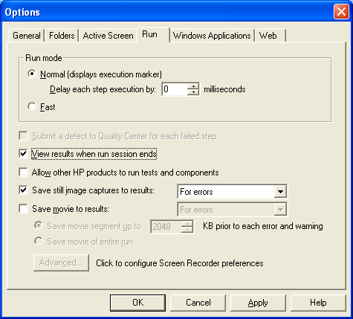
Setting Run Testing Options(Contd…)
Setting the Testing And Global options
The Run tab options affect how QuickTest runs tests and components and displays test results.

Slide 8
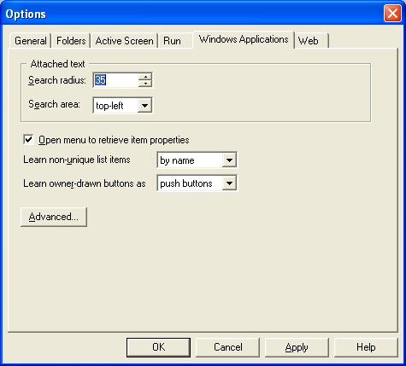
Setting Windows Application Testing Options
Setting the Testing And Global options
The Windows Applications tab options allow you to configure how QuickTest records and runs tests and components for Standard Windows, ActiveX, .NET Windows Forms, and Visual Basic applications.

Slide 9
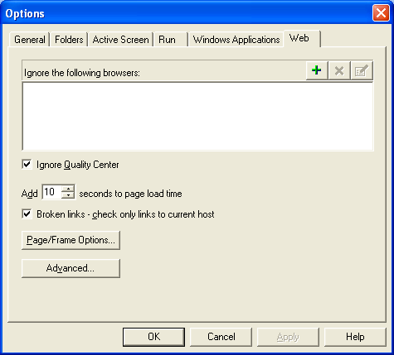
Setting Web Testing Options
Setting the Testing And Global options
The Web tab options determine QuickTest’s behavior when recording and running tests or components on Web sites.

Slide 10
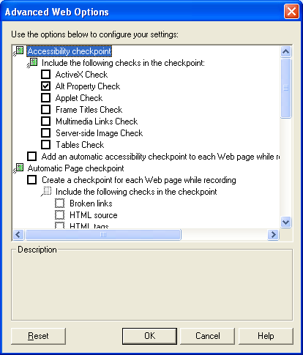
Advanced Web Options
Setting the Testing And Global options
The Advanced Web Options dialog box enables you to modify how QuickTest records and runs tests and components on Web sites.
  Automatic Web Page Checkpoint Options
  Record coordinates
  Record Navigate for all navigation operations

Slide 11
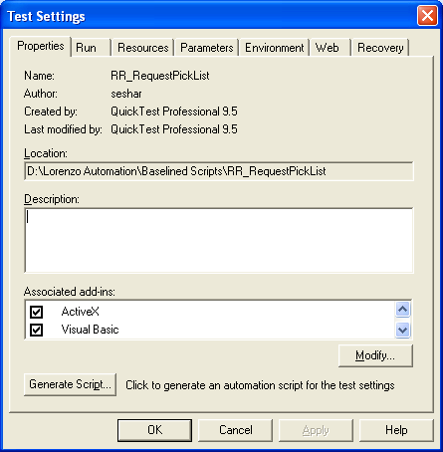
Setting Options for Individual Tests (Contd…)
Setting the Testing And Global options
Before you record or run a test, we can use the Test Settings dialog box to modify the testing options for the specific test.
Choose File > Settings or click the Test Settings toolbar button.

Slide 12
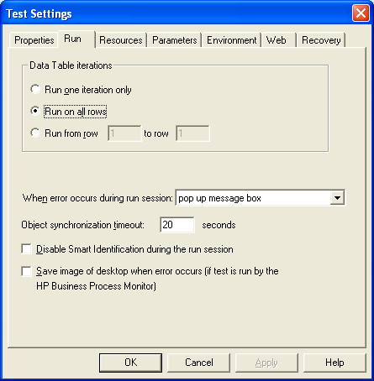
Setting Options for Individual Tests (Contd…)
Setting the Testing And Global options
Defining Run Settings

Slide 13
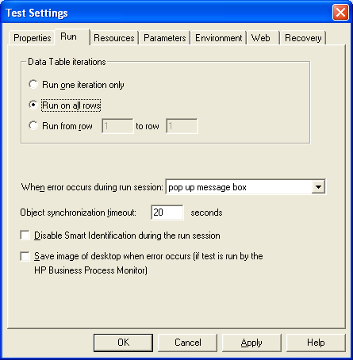
Setting Options for Individual Tests (Contd…)
Setting the Testing And Global options
Defining Parameters

Slide 14
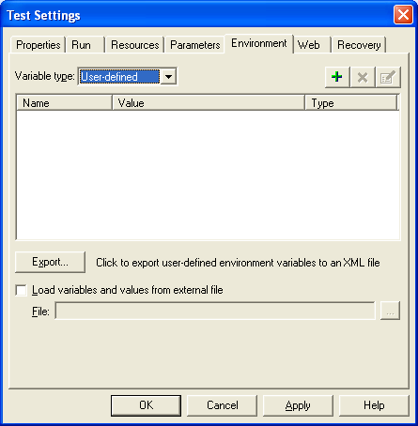
Setting Options for Individual Tests (Contd…)
Setting the Testing And Global options
Defining Environment Settings

Slide 15
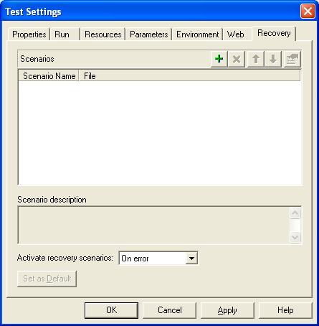
Setting Options for Individual Tests (Contd…)
Setting the Testing And Global options
Defining Recovery Scenario Settings

Slide 16
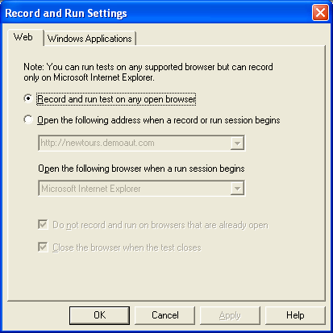
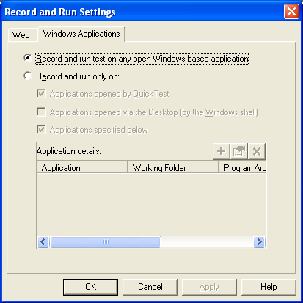
Setting Record and Run Options
Setting the Testing And Global options
Before we record or run a test on a Web or Windows application, we can use the Record and Run Settings dialog box to instruct QuickTest which applications to open when we begin to record or run your test.
Choose Automation > Record and Run Settings.

Slide 17
Summary of the Topics Covered
Setting the Testing And Global options
Set Global Testing options
Different Object Properties Types
Setting Options for Individual Tests
Setting Record and Run Options
Questions?

Slide 18

Thank You

